Slide 1
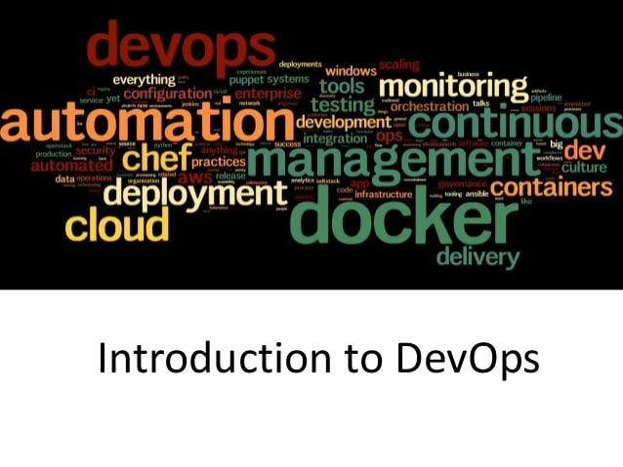

Slide 2
Agenda
Why DevOps Happened
What is DevOps?
DevOps Principles
DevOps Practices
How do we do DevOps ?
Agile and DevOps
When to adopt and when no to
QA

Slide 3
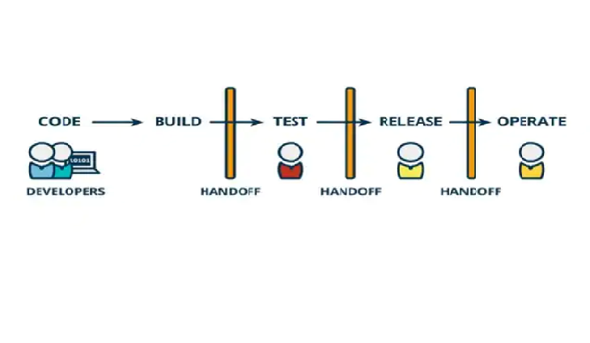
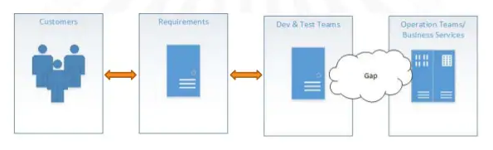
Why DevOps Happened?

Slide 4
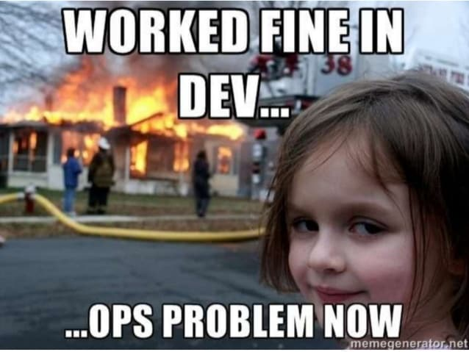
Why DevOps Happened?
Notes:
Dev View
Mostly delivers features after testing in development systems. Dev systems may not be same as production system. Developers will have faster turn around time w.r.t features. Not much concerned about the infrastructural as well as deployment impact because of the cod changes
Ops View:
Rewareded maintly for uptime. Lesser turn around time w.r.t feature deployment and testing due to large number of dev builds coming their way. Very much concerned about the infrastructural as well as deployment impact because of the code changes.

Slide 5
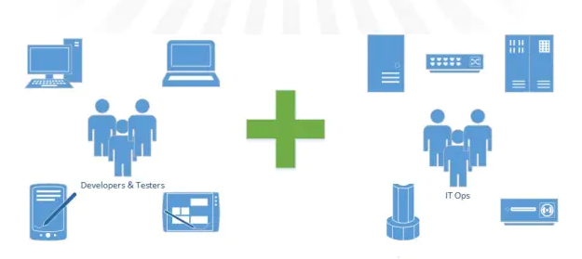
What is DevOps
DevOps is the practice of operations and development engineers participating together in the entire lifecycle, from design through the development process to production support

Slide 6
How is DevOps different from traditional IT
Old Process | DevOps
After placing an order for new servers, the Development team works on testing. The Operations team works on extensive paperwork as required in enterprises to deploy the infrastructure. | After placing an order for new servers Development and Operations team work together on the paperwork to set-up the new servers. This results in better visibility of infrastructure requirement.
Projection about failover, redundancy, data center locations, and storage requirements are skewed as no inputs are available from developers who have deep knowledge of the application. | Projection about failover, redundancy, disaster recovery, data center locations, and storage requirements are pretty accurate due to the inputs from the developers.
Operations team has no clue on the progress of the Development team. Operations team develop a monitoring plan as per their understanding. | In DevOps, the Operations team is completely aware of the progress the developers are making. Operations team interact with developers and jointly develop a monitoring plan that caters to the IT and business needs. They also use advance Application Performance Monitoring (APM) Tools
Before go-live, the load testing crashes the application. The release is delayed. | Before go-live, the load testing makes the application a bit slow. The development team quickly fixes the bottlenecks. The application is released on time.

Slide 7
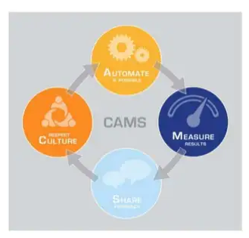
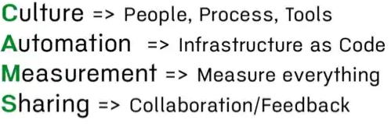
DevOps Principles

Slide 8
DevOps Practices
Version Control for all
Automated Testing
Proactive Monitoring and Metrics
Kanban/Scrum
Visible Ops/Change Management
Configuration Management
Continuous Integration/Deployment/Delivery
Virtualization/Cloud/Containers
Transparent Uptime/Incident Retrospectives

Slide 9
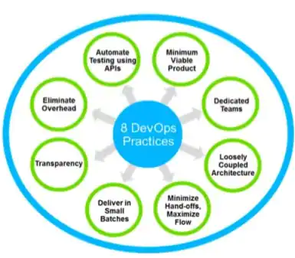
DevOps Practices
Version Control for all
Automated Testing
Proactive Monitoring and Metrics
Kanban/Scrum
Visible Ops/Change Management
Configuration Management
Continuous Integration/Deployment/Delivery
Virtualization/Cloud/Containers
Transparent Uptime/Incident Retrospectives

Slide 10
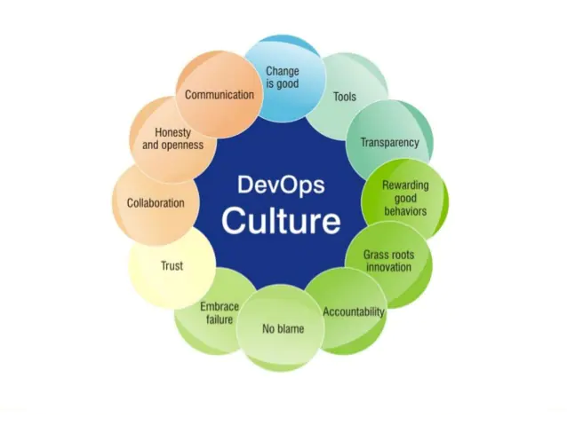
How do we do DevOps ?

Slide 11
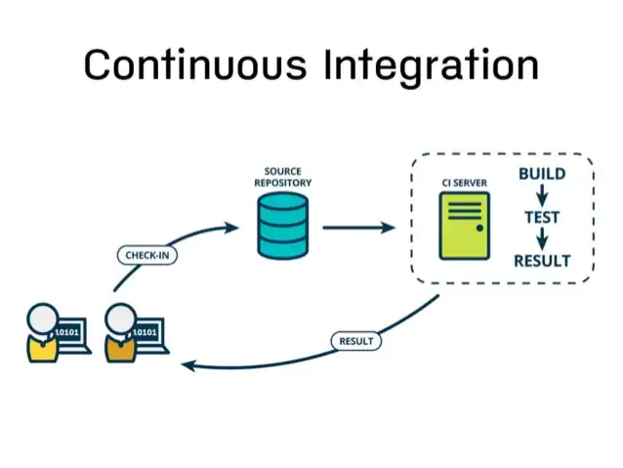
How do we do DevOps ?

Slide 12
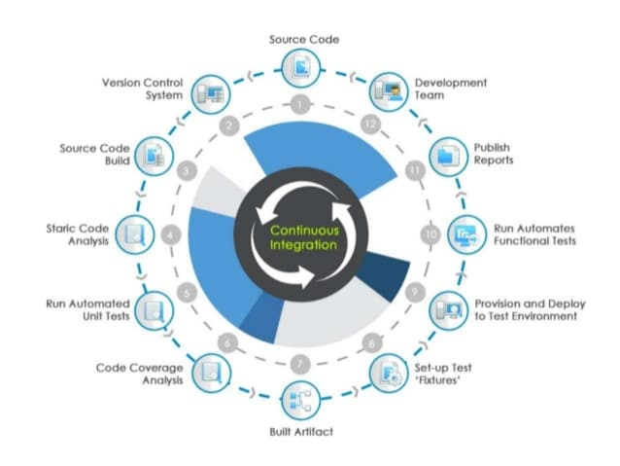
How do we do DevOps?

Slide 13
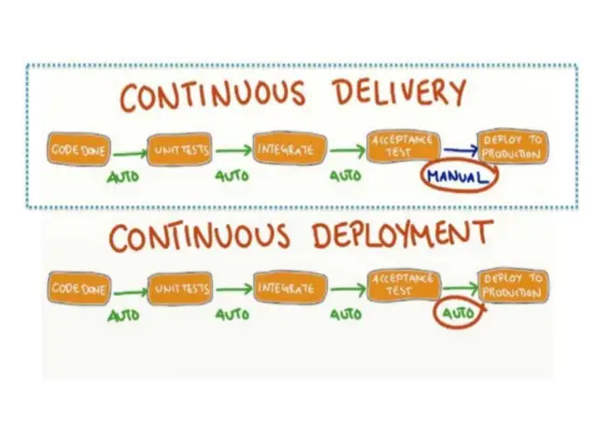
How do we do DevOps

Slide 14
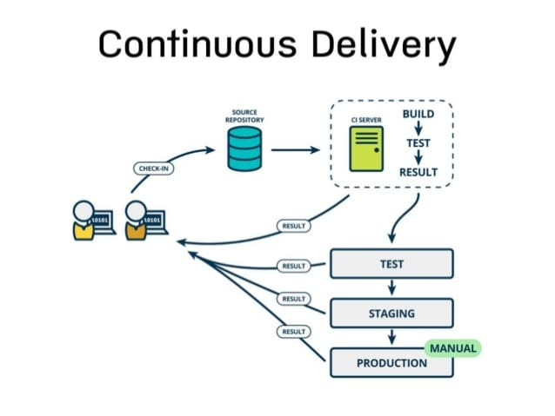
How do we do DevOps ?

Slide 15
Agile and DevOps
Agile Development
Address the gap between customer requirements and dev+ testing teams
Cross-functional teams to design, develop and test features/stories prioritised by the Product owner(Customer)
Focuses more on functional and non-functional readiness
DevOps
Address the gap between dev + testing and Ops
Automated release Management
Focuses on functional and non-functional plus operational and business readiness
Intensifies reusability and automation

Slide 16
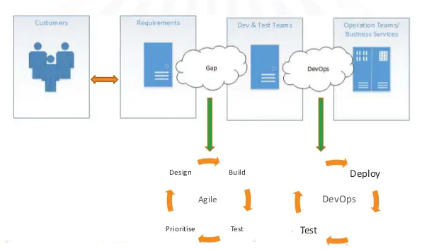
Agile and DevOps

Slide 17
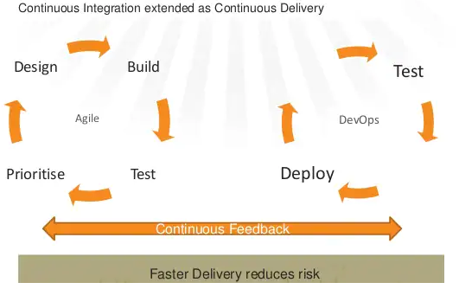
Agile and DevOps

Slide 18
When to adopt and when no to
When to Adopt:
For eCommerce and other web site projects (Amazon, Flickr, Netflix, etc)
Microservices based applications
Cloud Platform ( IaaS and PaaS)
When not to Adopt
Large Monolithic Applications

Slide 19
QA

